Slide 1

MDIS PULSE
MDIS Festival 2026
Done by Chezhian Sunjai
One Community, One Beat
Edited by XXXXX

Slide 2
Event Details
NAME : MDIS PULSE
DATE : 17 APR (Fri), 10am – 10 pm
Venue: In House

Slide 3
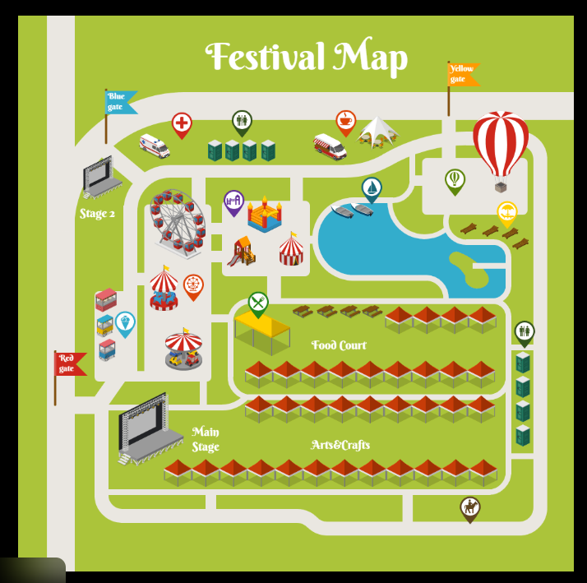
Event Concept
Decentralized
multiple micro-locations, Different experiences simultaneously
Examples
F1 Village, Olympic Villages

Slide 4
ZONES
Zone 1
Zone 2
Music Festival
Venue: Canteen
Pulse Amphitheatre
Venue: Amphitheatre
Zone 3
Food Truck Garage
Venue: Block F Carpark

Slide 5
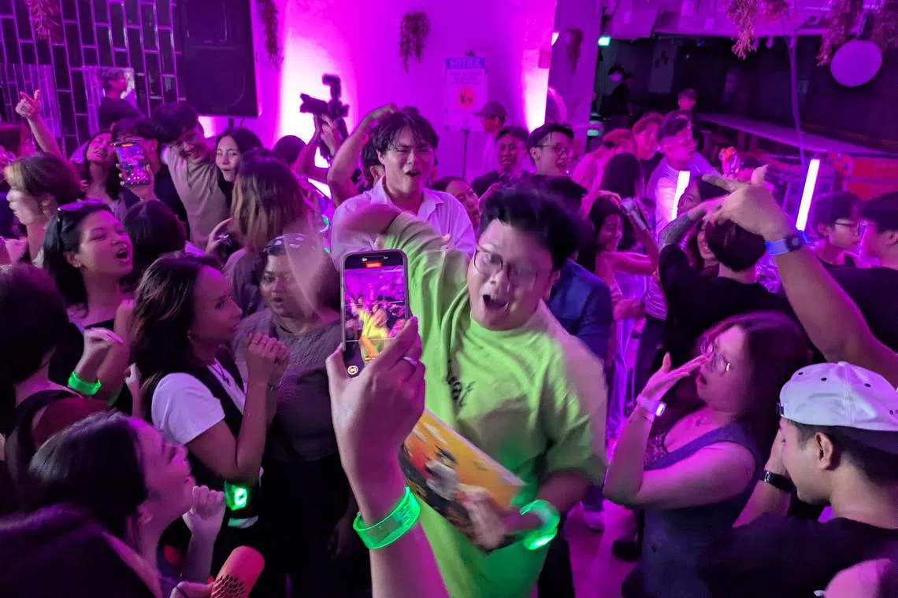
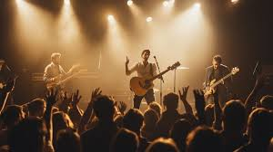
Zone 1 ( Music Festival )
Canteen → Rave
The Idea Turn a familiar canteen into a high-energy night space for one night. Same location, totally different vibe. The goal is to surprise people and show how an everyday space can become something unforgettable.
What Changes
Lights down, LEDs up
DJ + sound system
Visuals to wipe out the “canteen feel”
Why It Works
Unexpected = memorable
Uses an existing space in a new way
Brings people together, boosts energy, creates buzz

Slide 6
Zone 1 ( Music Festival )
Please provide any Renditions or 3d mock ups, or ideas you think we can do!

Slide 7
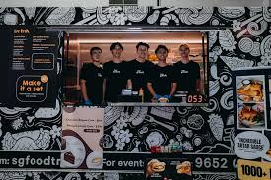
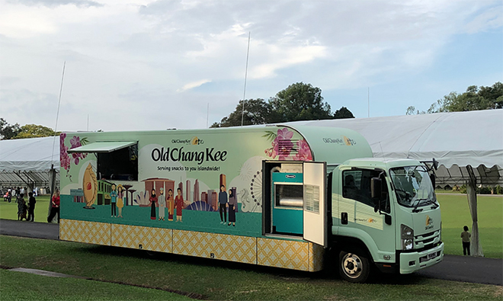
Zone 2 (Food Truck)
Carpark into a Food Street
The Idea Activate an open area with a curated lineup of food trucks, music, and lighting to create a relaxed, festival-style hangout. It’s about good food, good energy, and an easy place for people to gather.
What’s Happening
Multiple food trucks with different cuisines
Casual seating + standing zones
Music playing throughout the space
Why It Works
Food is the main draw, vibes do the rest
Flexible setup, low build, high impact
Encourages people to stay longer and socialise

Slide 8
Zone 2 (Food Truck)
Please provide any Renditions or 3d mock ups, or ideas you think we can do!

Slide 9
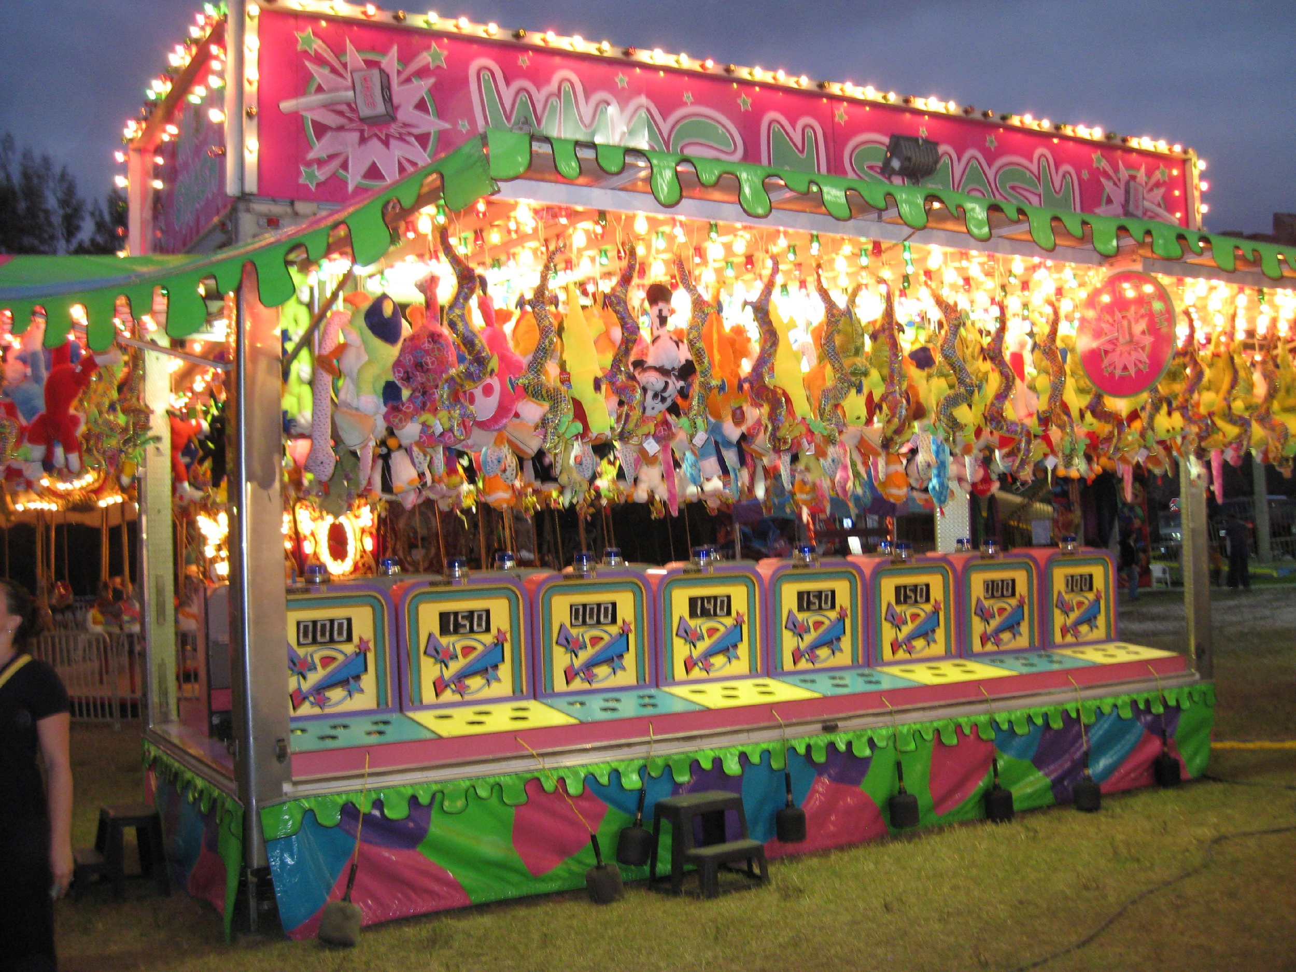
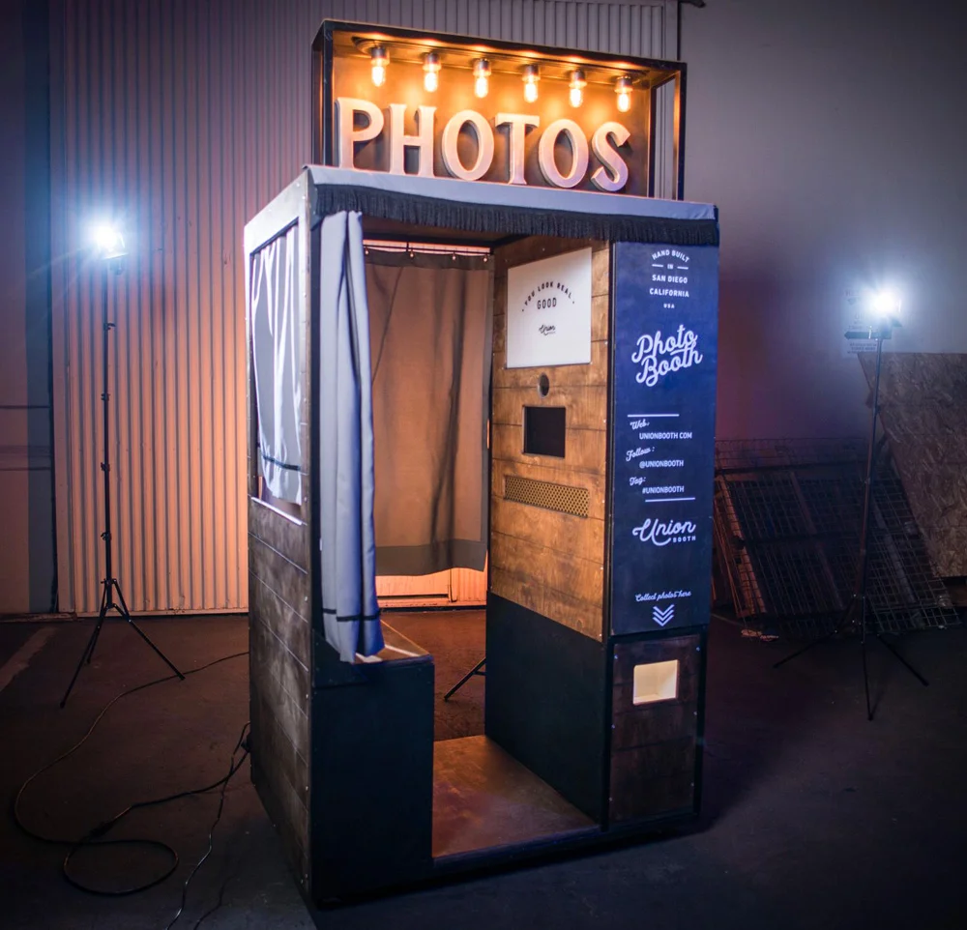
Zone 3 (Pulse Amphitheatre)
The Idea Rework the amphitheatre into a central activity zone packed with carnival-style games and photobooths.
What’s Inside
Carnival games
Photo booths + interactive backdrops
Easy-flow layout so people can drop in anytime
Why It Works
Games pull people in naturally
Photo moments drive participation and sharing
Keeps the crowd engaged between main highlights
The Result Instead of just watching, people are doing. The amphitheatre shifts from passive seating to an active social hub.

Slide 10
Zone 3 (Pulse Amphitheatre )
Please provide any Renditions or 3d mock ups, or ideas you think we can do!

Slide 11
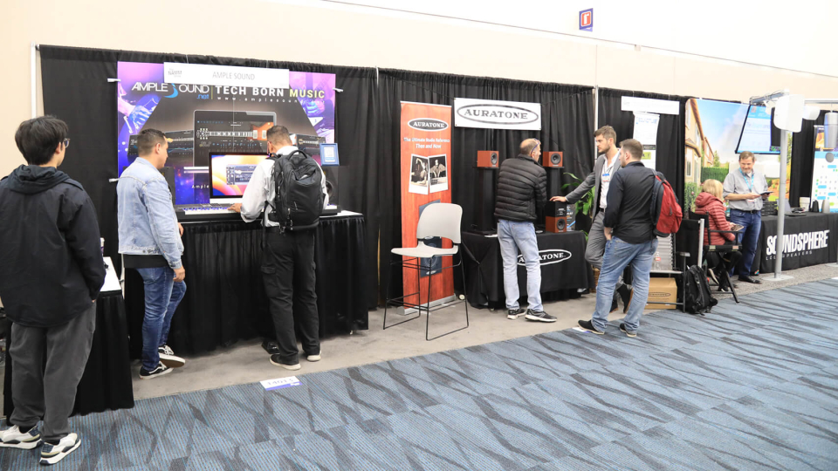
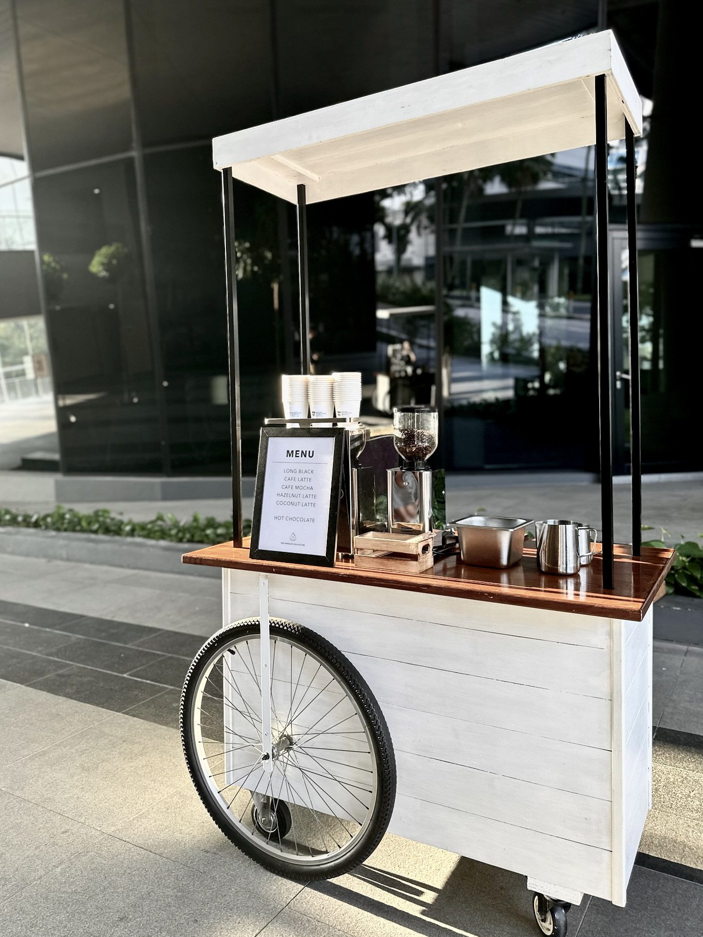
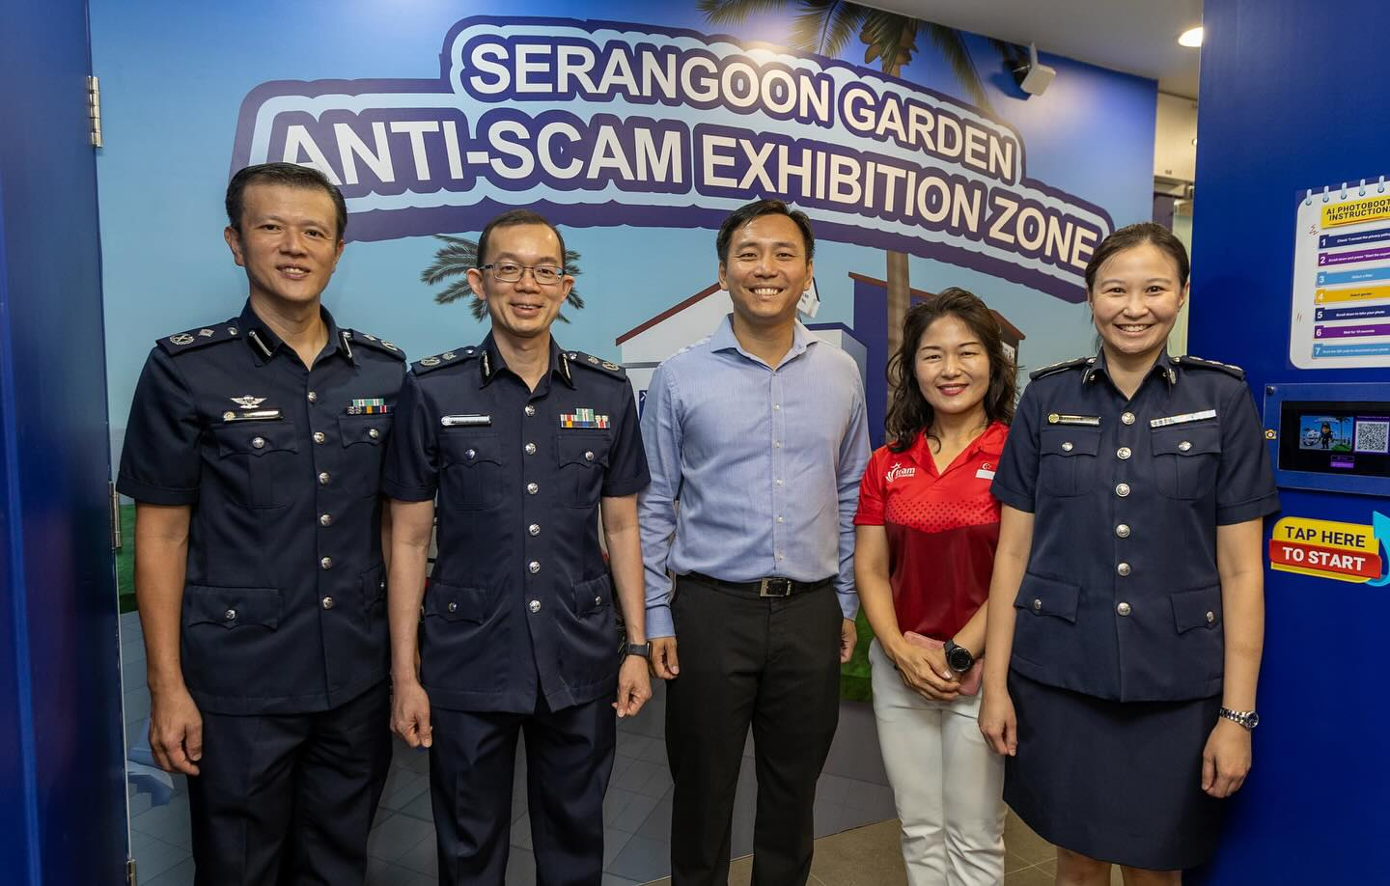
BOOTHS
Sales / Consultation
Individual School
MDC
SQC
Registration counters
Corporate Members e.g. Ernies

Slide 12
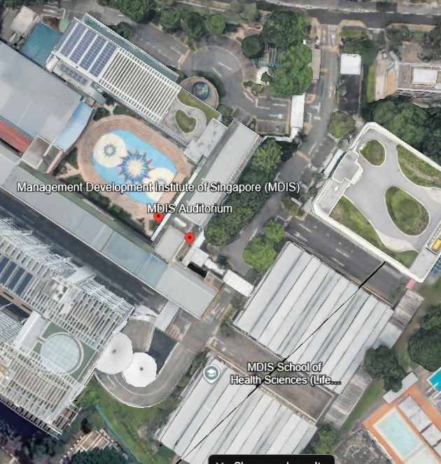
Expressway
The Centre Road will be Closed.
Spread out Booths (SQC, TCC, MDC, Schools & sales, corporate members)

Slide 13
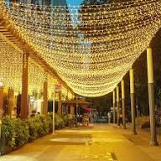
Expressway
The Area in red will have various booth.
The Booths will be spread across the road.

Slide 14
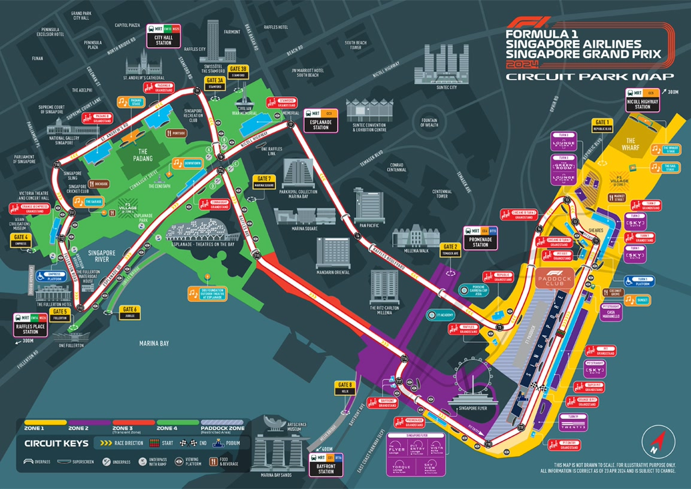
QR Code Map Rendition
MDIS Event Map
Include schools
Rooms (TB, brainwaves)
Activities that are happening
Cost: $XXXX

Slide 15
Who are the Potential Leads
Neighbourhood
Parents ( Adult Learners )
Children ( Youth )
Community centre Volunteers
Masjid
Adults
Youths
Muslim Community
SPF
Soon to ORD
NSF
Regulars

Slide 16
HOW WE GET LEADS
Registration/Sign up
Sales / Sessions
Consultation / School Booths
Engagement Activities
Workshops, photobooths
Post-Event
Follow-up emails

Slide 17
Sustainability & AI Talks - Sharon
Each speaker will conduct a 30-minute session to give participants a simple and practical introduction to the topic
what it means, why it matters, and how it affects organisations and individuals.
The talks will be scheduled in the morning before lunch, to allow participants to attend easily as part of the day’s programme.
We will invite:
• Our existing corporate clients, and
• MDIS Corporate Members
This session will:
• Add value to the Celebration Day programme,
• Provide useful learning content for participants,
• Create a platform for networking between clients, members, and MDIS, and
• Allow MDC to showcase and promote relevant courses in Sustainability, ESG, AI, and digital skills.

Slide 18
Booth Tiers – Corp. members/ Vendors (FYI)
Standard
1.5m table
Chairs x2
- Pull Up Banner
$xxx
Plus
2m table
Chairs x2
- Backdrop
- Social media post
- MDC Rebates (TBC)
$xxxx
Ultra
3mx3m booth
4 round tables
- Digital TV stand
- Social media post
- MDC Rebates (TBC)
- Future Venue sponsorship
- 1 x Email Blast to our corporate members
$xxxxx

Slide 19
Booth Tiers – Renditions or 3D Mock ups
Standard
Plus
Ultra

Slide 20
Estimated Cost – Zone 1 Breakdown
Item | Qty | Cost (SGD) | Remarks
DJ
Audio & Lighting
Power supply
Décor
TOTAL
*Feel Free to add more items, however, Do not change what was given.

Slide 21
Estimated Cost – Zone 2 Breakdown
Item | Qty | Cost (SGD) | Remarks
Games booth
Activity Crew
Photo booth
Tables & Chairs
TOTAL
*Feel Free to add more items, however, Do not change what was given.

Slide 22
Estimated Cost – Zone 3 Breakdown
Item | Qty | Cost (SGD) | Remarks
Food Truck fees
Power Supply
Audio/Lighting
Tables / Standing tables
TOTAL
*Feel Free to add more items, however, Do not change what was given.

Slide 23
Estimated Cost – Expressway Breakdown
Item | Qty | Cost (SGD) | Remarks
Booth Structures
Power points
Branding (banners / backdrops)
TOTAL
*Feel Free to add more items, however, Do not change what was given.

Slide 24
Estimated Cost – Registration Breakdown
Item | Qty | Cost (SGD) | Remarks
Registration Counters
Tablets
Wristbands/Lanyard
Registration Staff
Signage
TOTAL
*Feel Free to add more items, however, Do not change what was given.

Slide 25
Estimated Cost – General Breakdown
Item | Qty | Cost (SGD) | Remarks
Event management
Photography / videography
Licenses / permits
TOTAL
*Feel Free to add more items, however, Do not change what was given.

Slide 26
$XXXXX
Total Cost for Entire Event

